Slide 1
SportsPlex Sprint 5
Presented By: Edward Marks, Peter Kowalski, Matt Degraeve, Anthony Saleh, Graydon Peck, Colin Neil

Slide 2
Sprint 5 Goals
Create Rink Rental System
Main page rink functionality

Slide 3
Next Sprint Goals
Create employee timesheet system
Create interactive rink map on main page so guest can see an overview of events
Create video page
Finish up more Usecase Diagrams.
Add additional usecase

Slide 4
Main Use Cases

Slide 5
Use Case-17 A manager can make the employee’s schedule
Initiating Actor(s):
Manager
Actor’s Goal:
Make the weekly schedule so that an employee is assigned to each work station throughout the week.
Preconditions:
The manager is logged in
Postconditions:
The manager can see the weeks schedule
The employee can see their schedule

Slide 6
Flow of Events for Main Success Scenario:
The manager logs into their home page.
The manager selects the week that they want to work on the schedule for.
The manager clicks the “edit schedule” button.
The manager chooses an employee and station to assign for the particular day.
Exceptions
The selected employee cannot work that day
The selected employee is assigned to another station at that time

Slide 7
Use Case-18 An employee can view their schedule
Initiating Actor(s):
Employee
Actor’s Goal:
An employee can view when they are scheduled to work and optionally can request not to work on a certain day.
Preconditions:
The employee is logged in.
Postconditions:
The employee can see the weeks schedule.
The manager can see if an employee is unavailable to work.

Slide 8
Flow of Events for Main Success Scenario:
The employee logs into their home page
The employee’s schedule will populate on the page.
The employee can click the “edit availability” button.
The employee can select what day they cannot work and provide a reason why for the manager.
Exceptions
The employee is not scheduled to work

Slide 9
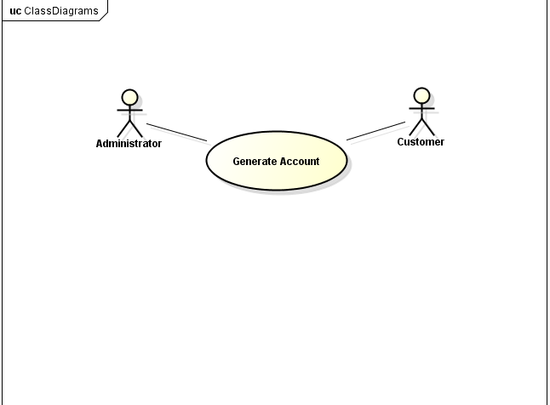
UC-GenerateAccountInfo
Usecase Diagram

Slide 10
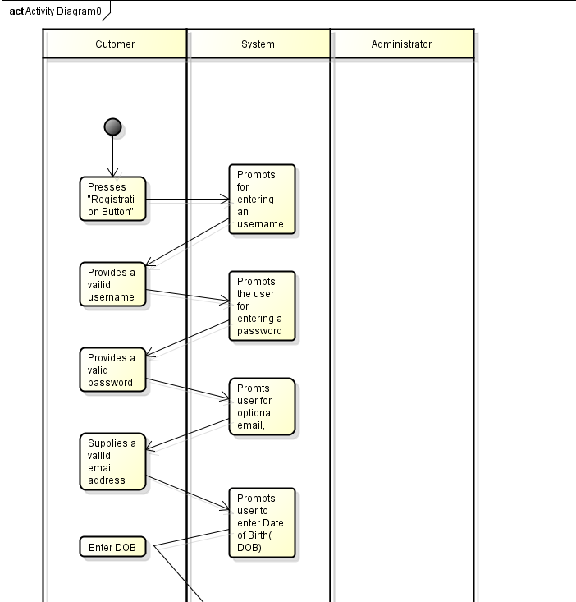
UC-GenerateAccountInfo Continued
Activity Diagram

Slide 11
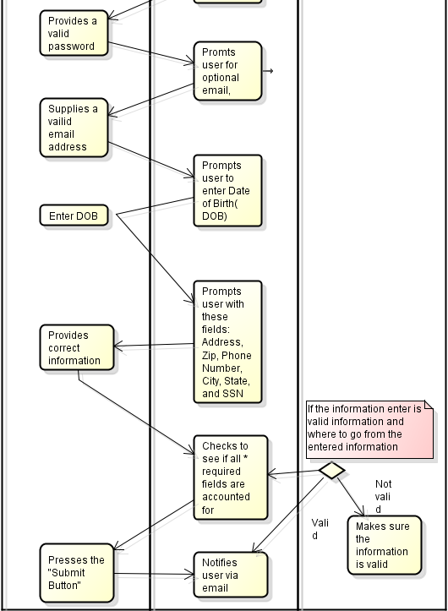
UC-GenerateAccountInfo Continued
Activity Diagram

Slide 12
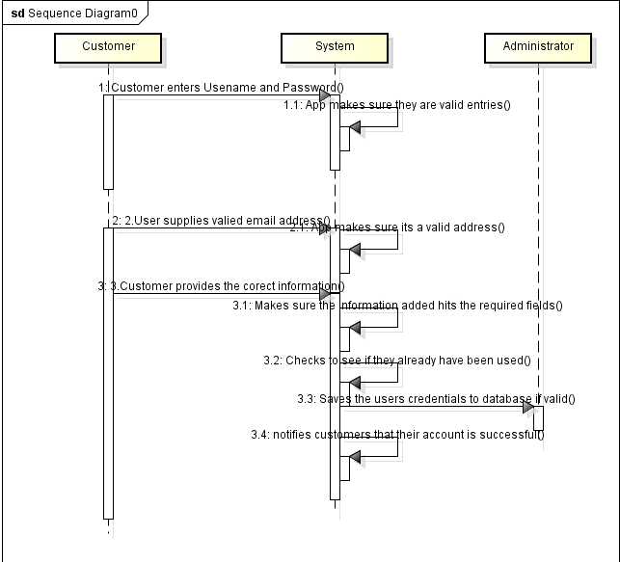
UC-GenerateAccountInfo Continued
Sequence Diagram

Slide 13
END

